Slide 1

Sign Language Detection and Conversion to Text Using CNN and OpenCV
Debayan Das(19MCA0070)
Master of Computer Application
Vellore Institute of Technology, Vellore

Slide 2
Problem Description:
This paper focuses on making an interface between the normal people and that deaf and dumb people with the help of computer vision. To do so first a classification model is built to identify the sign alphabet using CNN and then for real time application the hand gesture sign is detected using OpenCV and fed to the model to make the final prediction. And after recognition it is converted to text for further use.

Slide 3
Literature Review:
Title | Description | Author
Sign Language Translator Using CNN Model. | In one study an interface is made to make the conversation easier between a normal people and the one with disabilities. For this they have used CNN model. They have trained the model with the hand gesture images and then the have deployed the model with the interface. The detects the gesture from the one with the disabilities and then convert it to text and displays it and converts into speech for both way communication. | Jose, D. A. A. R. D., & Davis, J. (2019).
American Sign Language alphabet recognition using Convolutional Neural Networks with multiview augmentation and inference fusion | In another study an interface is created to convert sign language to text using CNN model by data augmentation technique. They images were captured by Microsoft Kinect. The images were augmented to generate more perspective views to avoid the overfitting. | Tao, W., Leu, M. C., & Yin, Z. (2018).

Slide 4
Literature Review:
Title | Description | Author
Iterative alignment network for continuous sign language recognition. | In this work a framework is proposed to interpret sign language and convert it to text. For this a CNN model is used which is trained by preprocessed hand gesture image dataset. | Pu, J., Zhou, W., & Li, H. (2019)
Gesture Recognition of RGB and RGB-D Static Images Using Convolutional Neural Networks | In this study [6] a deep neural network model is used to convert to natural language sentences from sign videos by the utilization of human keypoint extraction like face, hand and gesture recognition. For this “KETI” (Korea Electronics Technology Institute) dataset which is a sign language dataset is used. The translation model achieved 93.28% accuracy. | Khari, M., Garg, A. K., Crespo, R. G., & Verdú, E. (2019).

Slide 5
Literature Review:
Title | Description | Author
Sign Language Interpretation and Conversion to Text | In another approach an alignment framework is proposed with iterative optimization. The framework have two modules: a “3D-Resnet” which is used to learn feature and “CTC” an encoder with decoder sequence learning network where two decoders (“LSTM”, “CTC”) are togetherly trained with the criterion of maximum likelihood. | Ghaste, P. V., Bastwade, M. S., Khandelwal, R., Ambapkar, S., Ansari, Z., & Salaria, C. S. (2019)
Neural sign language translation based on human keypoint estimation | In this paper they propose “RGB”, “RGB-D”. These are static gesture recognition method by the use of a fine-tuned “VGG19” Model and this uses a feature concatenate layer of those images to increase the accuracy. They got 94.8% accuracy on implementing the model on American Sign Language recognition dataset. | Ko, S. K., Kim, C. J., Jung, H., & Cho, C. (2019)

Slide 6
Literature Review:
Title | Description | Author
A person independent system for recognition of hand postures used in sign language | In another study [7] a support vector machine (SVM) based recognition is used to identify hand gestures. The model uses a function of eigen space size and features of human moments for the classification of different hand features. | Kelly, D., McDonald, J., & Markham, C. (2010)
Recognizing Sign Languages Using Pattern Recognition. | In this study [8] they have used 3D-CNN model to recognize the hand gestures and to convert them to text. They captured the images frames using OpenCV and trained the CNN model with the frames. | Ismunandar, A. A.

Slide 7
Previous Work:
In the previous researches we found either of CNN or OpenCV is used to recognize sign language. Using CNN the classification model gets better accuracy whereas using OpenCV image processing features the application becomes real time but in this case accuracy is less and using CNN the application does not become real time it stays static.
Our Work:
In our case we tried to merge the advantages of both the processes. Using CNN we are getting better accuracy and using OpenCV the application becomes real time that will be helpful for the society.

Slide 8
Dataset Description:
The dataset is the American Sign Language dataset that is collected from Kaggle datasets. The dataset contain 1825 images that are already labeled in 36 classes A-Z[26] and 0-9[10].

Slide 9
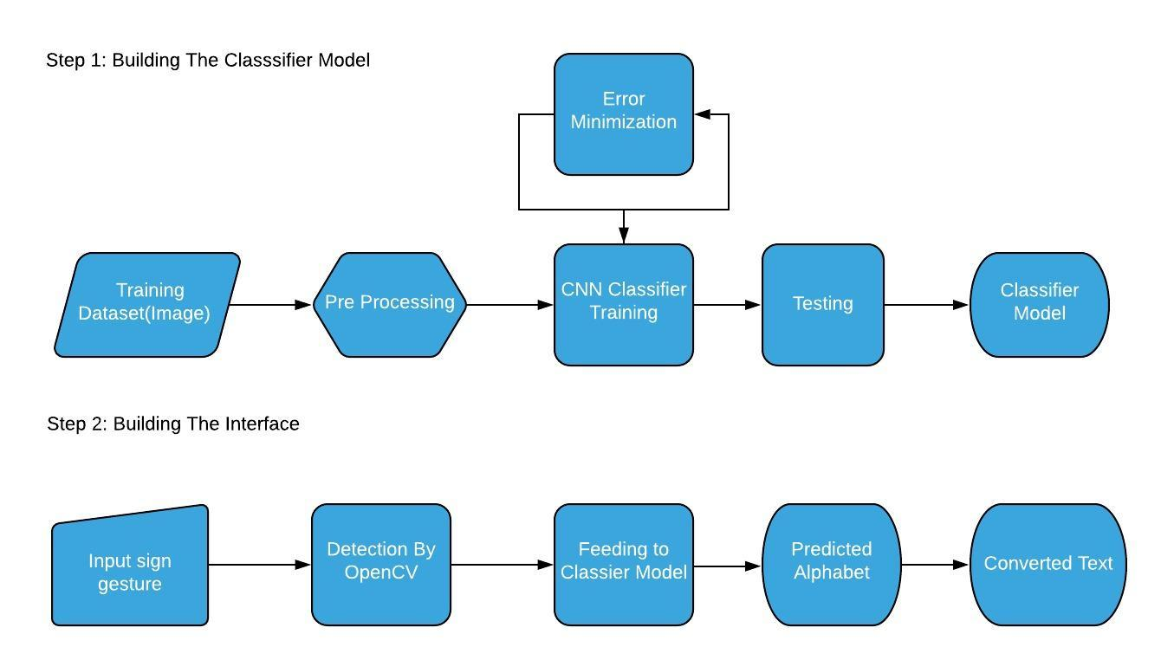
Work Plan:

Slide 10
Module Description:
The modules for the project are:
Preprocessing
Training the CNN model
Making the Interface

Slide 11
Preprocessing:
The first task is to preprocess the images. In order to do so first a background of dark is pasted around all the images and the images are converted to ‘RGB’ format to make the image channels similar. Next all the images are transformed to similar dimension 400x400. At the end images are saved but while saving the images extension of the images are changed to .jpeg from .png.

Slide 12
Training the CNN model:
In the second step the CNN model is trained with the images which are classified to 36 classes (A-Z and 0-9) previously. The CNN model contains total 9 layers. First two are two convolution layers followed by 1 maxpool layer. Then again two convolution layer followed by 1 maxpool layer. Then there is one flatten layer which is followed by two fully connected layer(dense). For optimizing the model “stochastic gradient descent” (SGD) method is used and the model is trained for 10 epochs

Slide 13
Making the Interface:
The 3rd step is to make the interface that will interpret the sign language and will convert to text. This will be made using OpenCV library of python. The image will be captured and will be made ready so that it can be fade to the CNN model and the output of the model will be displayed in the screen.

Slide 14
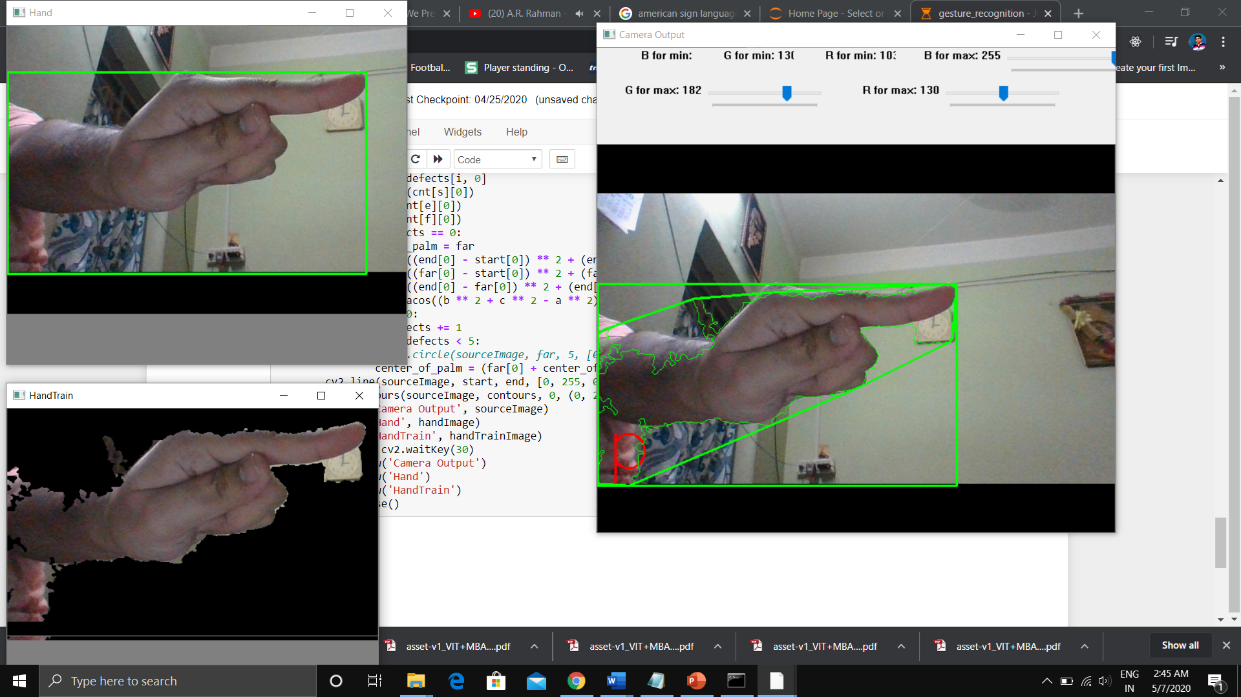
Results:
The trained model is giving 99% accuracy. And the interface is stable.

Slide 15
Conclusion:
This system can be used in the medical, educational and many other fields. We will be very happy if the system comes in use of society and people. In the next versions we will try to make the system more accurate and stable than this version and will try to add other features like convert the text to some other language based on the choice of the user and converting the text to speech and we will try build an android version of the system.

Slide 16
Thank You

